Slide 1


CrowdStrike 2024 Global Outage – Case Study Software Engineering & Agile Development (SEAD)
Submitted By: Pathan Mohammed Akram Khan Reg No: 2023BCSE07AED041 Class: VI CSE AIML A
Under the Supervision of Dr. Sengottaiyan N

Slide 2
Abstract
Global outage caused by faulty kernel-level update
Failure in Agile governance and DevOps pipeline
Impacted aviation, banking, healthcare sectors
Case study analyzed using SEAD principles
Focus on SDLC, risk management, and ethical practices

Slide 3
Introduction
Agile & DevOps enable rapid continuous delivery
Lack of disciplined engineering introduces risks
CrowdStrike outage shows real-world software crisis
Highlights importance of safe update deployment

Slide 4
Problem Statement
Frequent automated updates in cybersecurity systems
Kernel-level update released without full validation
No staged rollout or rollback mechanism
Result: Global Blue Screen of Death (BSOD) failures

Slide 5
Requirement Analysis
Functional Requirements
Validate update packages
Monitor system behavior
Provide automatic rollback
Non-Functional Requirements
Performance & reliability
Security validation
Scalability for global deployment

Slide 6
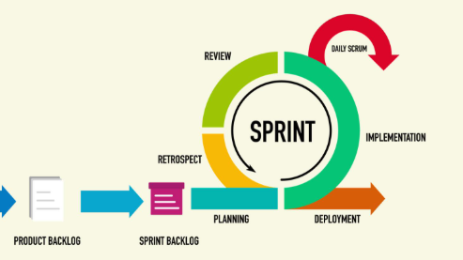
SDLC Model Used (Agile)
Agile iterative lifecycle with continuous releases
Planning → Development → Testing → Deployment → Feedback
Faster delivery compared to Waterfall
Weak validation phases caused deployment risk

Slide 7
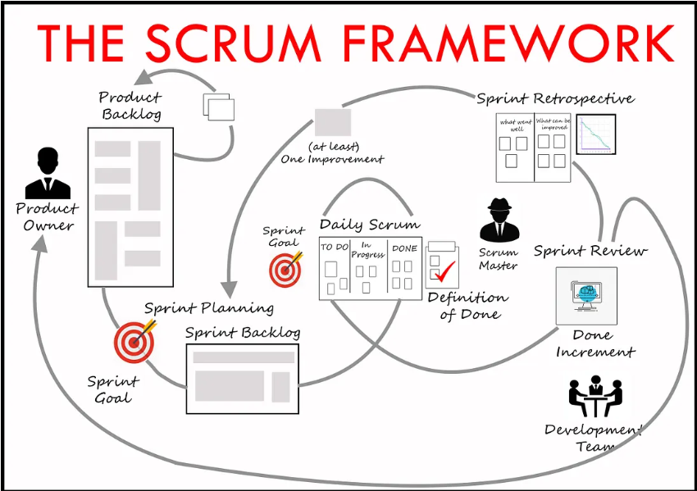
Agile Methodology Applied (Scrum)
Product Backlog: Security updates & patches
Sprint Planning: Prioritized detection improvements
Daily Stand-ups: Tracked development progress
Review & Retrospective: limited focus on deployment risks

Slide 9
Organization Background
CrowdStrike Falcon – endpoint cybersecurity platform
Kernel-level agent for threat detection
Cloud-based analytics & CDN update distribution
Requires extremely reliable deployment controls

Slide 10
Incident Description
Date: 19 July 2024
Faulty content update released globally
Triggered Windows BSOD errors
Manual recovery required on each endpoint

Slide 11
Technical Root Cause
Malformed channel file in CsAgent.sys driver
Missing memory validation checks
Insufficient kernel compatibility testing
Automated pipeline allowed faulty release

Slide 12
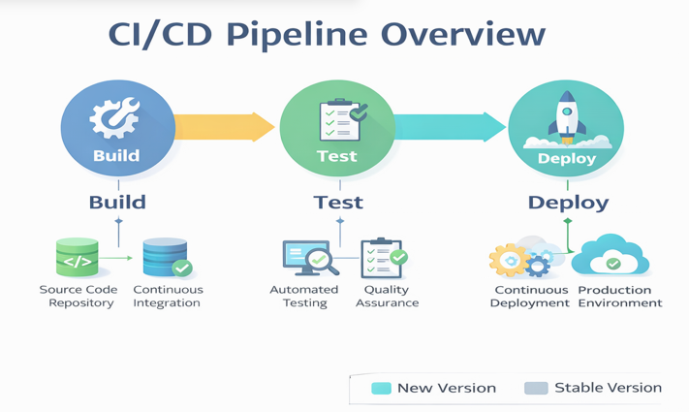
DevOps Pipeline Failures
No canary or phased deployment strategy
No automated rollback mechanism
Limited regression & compatibility testing
Insufficient monitoring and observability

Slide 14
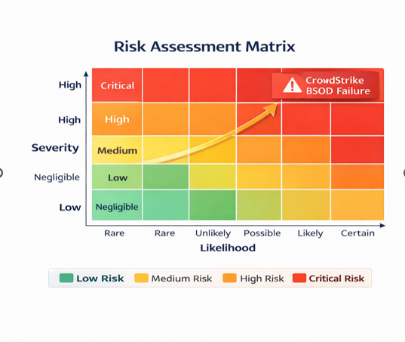
Risk Analysis
Kernel update = High likelihood & Critical impact
Lack of formal risk assessment matrix
No mitigation planning before deployment
Required staged release and fallback mechanisms

Slide 16
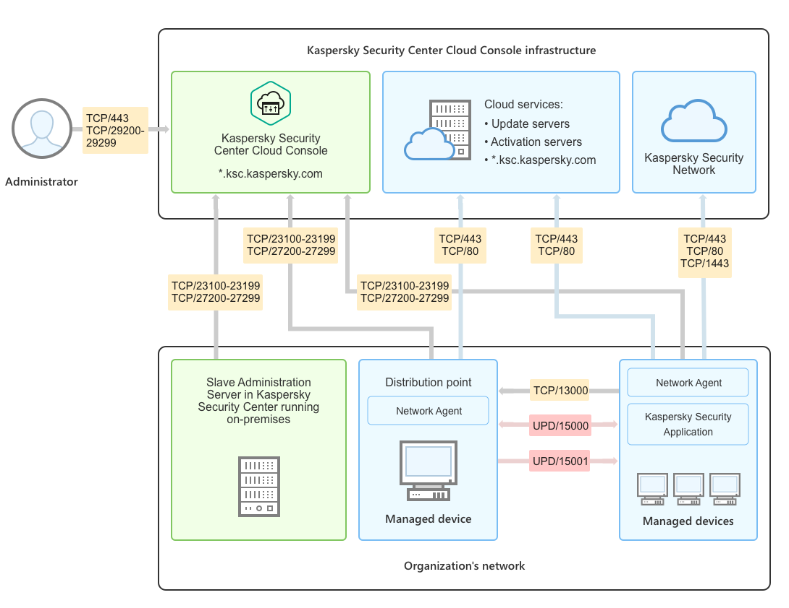
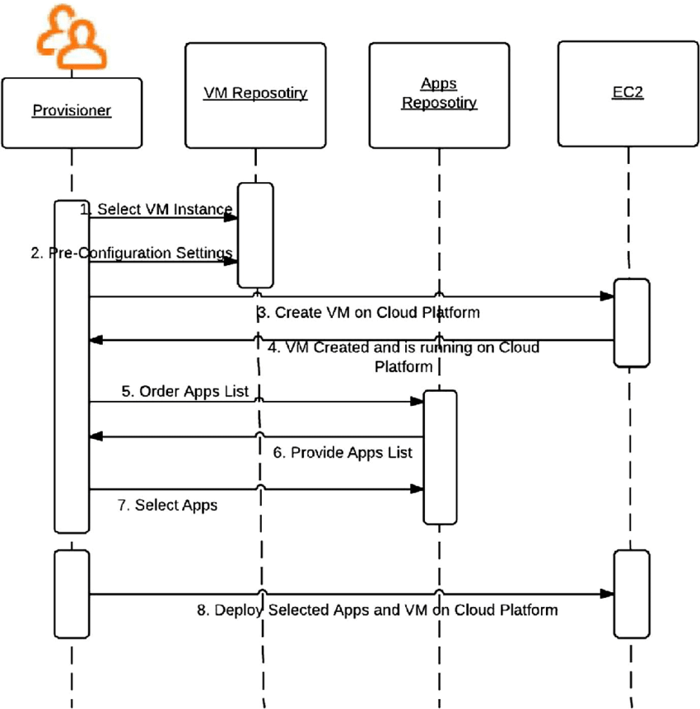
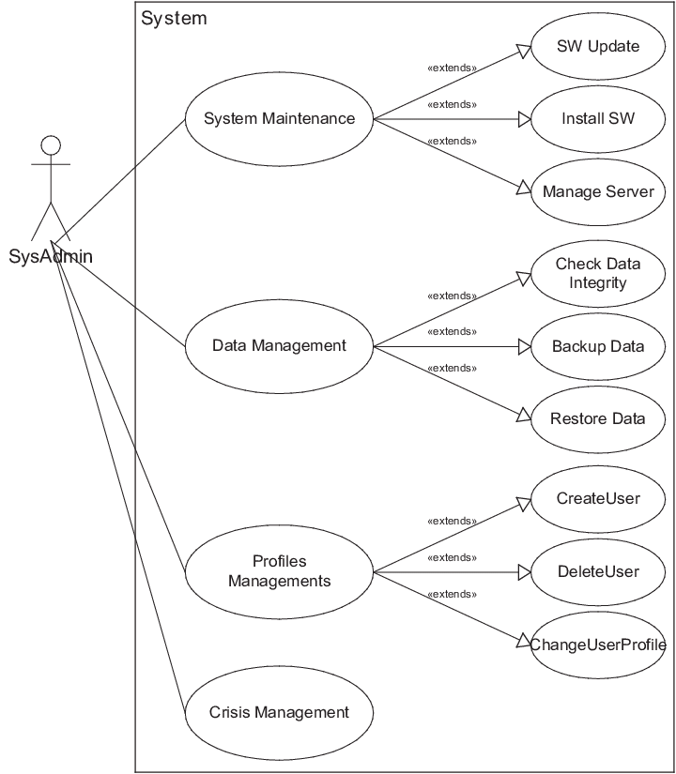
System Design (UML Overview)
Architecture: endpoint agents + cloud analytics + console
Use Case: admin deploys update → system validates → monitors → rollback
Sequence: deployment → validation → telemetry → failure detection → rollback

Slide 18
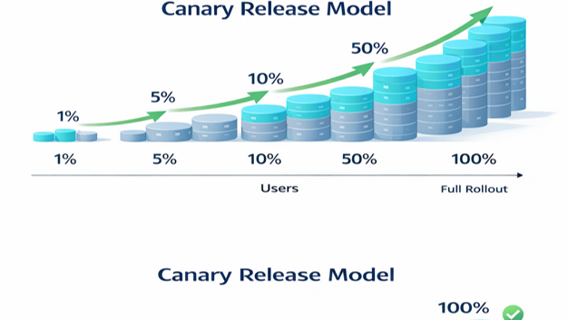
Recommendations
Canary deployment (1–5–10–50–100%)
Automated rollback for failed updates
Dedicated kernel-level testing labs
Formal Change Advisory Board (CAB) governance

Slide 19
Conclusion & Learning Outcomes
Agile must be disciplined with strong SE practices
Process quality is more important than release speed
Learned SDLC integration, risk analysis, DevOps governance
Ethical responsibility critical in safety-critical systems

Slide 20


